Slide 1
eBPF in the Shell: Deploying Kernel Logic on Reconfigurable Hardware
Simone Mannarino < simone.mannarino@mail.polimi.it > ​
AOHW25_416

Slide 2
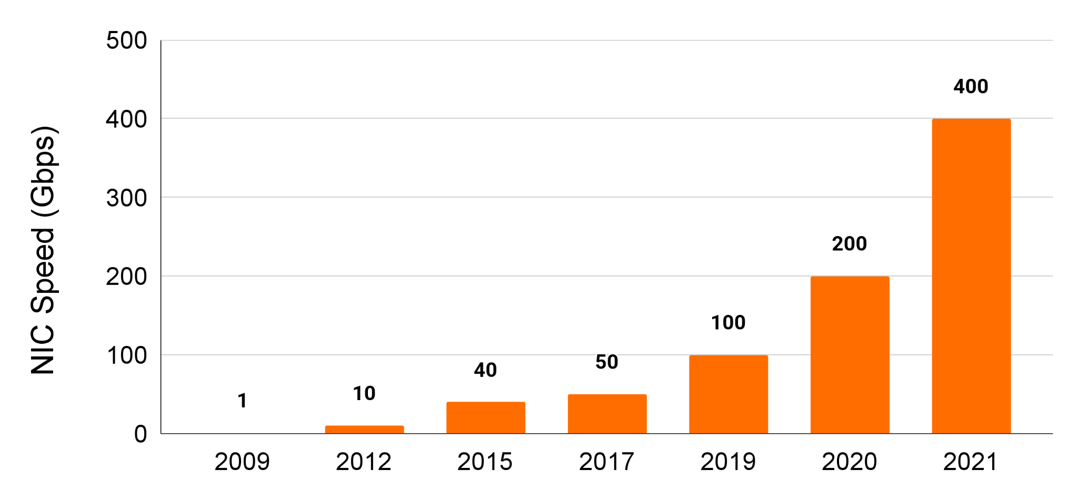
Network packet processing speed is crucial​

Slide 3







FPGA-Based SmartNICs eBPF empowered
CPU Offloading
High Performance with Minimal Overhead
High Performance and Low Latency
Code Portability
Flexibility and Programmability
Safe and Secure Execution
Thanks to Flaticon, Arkinasi, Freepik, Iconjam and Didin jpr for the images

Slide 4



Project contribution
Nanotube: eBPF to FPGA compiler​
OpenNIC: SmartNIC capable of executing the generated code
Thanks to Flaticon,iconixar,Triangle Squad and Muhammad Ali for the images

Slide 5

NOW IT’S DEMO TIME

Slide 6
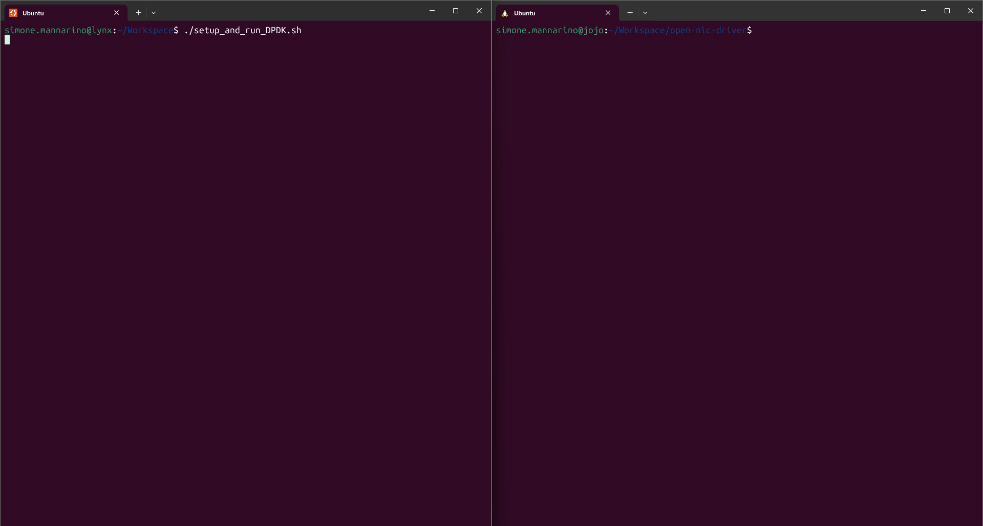

Slide 7


THANK YOU FOR YOUR ATTENTION
Simone Mannarino
< simone.mannarino@mail.polimi.it >

